Slide 1
The Data Incubator Scholar program interview
Amin Shafaat

Slide 2
About myself
Name
Mohammad Amin Shafaat
Education
PhD Candidate-Engineering Sciences and Mechanics (2015)
Pennsylvania State University-State College PA
Master of Science-Materials Science and engineering (2009)
Amirkabir University of Technology, Tehran-Iran
TDI Capstone Project
Model for predicting the date in which a product is most likely to be bought for an Online Retail company
PhD Research Project
Machine learning approach in particle sensing using Whispering Gallery Mode Resonator

Slide 3
Capstone Project
Title: Model for predicting the date in which a product is most likely to be bought for an Online Retail company
Data set: Online Retail data set which contains all the transactions occurring between 01/12/2010 and 09/12/2011 for a UK-based and registered non-store online retail for 541909 observations.
Products: unique all-occasion gifts
Varaibles
InvoiceNo, StockCode, Description, Quantity, InvoiceDate, UnitPrice, CustomerID, Country

Slide 4
Importance of the study
Multivariate logistic regression would help us determine the date in which a specific product is most likely to be bought.
Also, by grouping the gifts, sales department would be able to offer specific group of customers a group of products that they are likely to buy.
Similar analysis can be performed for cancelled items for the company itself and prevent waste of products and money.

Slide 5

Analysis
Cluster Analysis
Multivariate logistic regression
After data cleaning I try to make contingency table but presently I face memory problem with R
Cluster | Description
1 | Buy only In February 77184$/month
2 | 8 months of interaction 299$/month
3 | 2 months interaction 367$/month
4 | 12 Month of interaction 709$/month
5 | Last 4 months of year 14057$/month

Slide 6
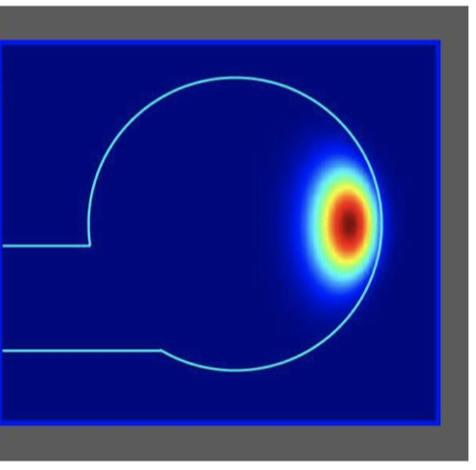
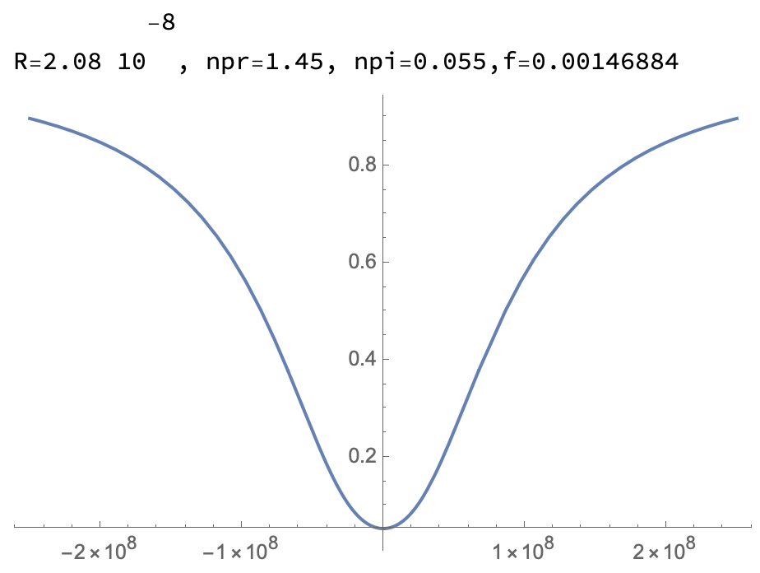
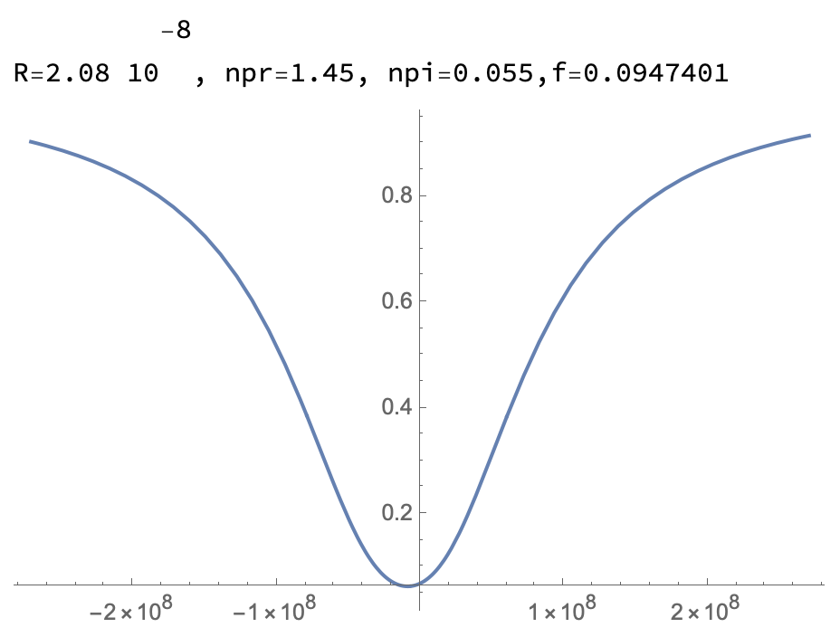
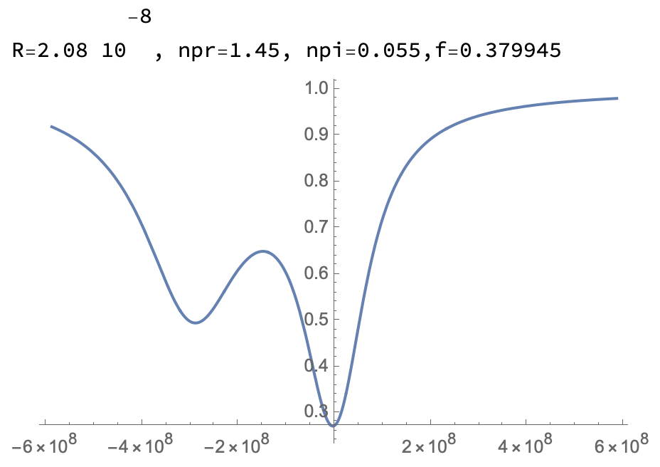
Derivation of transmission curve
Comments about the random parameter f(r)
Intensity of light varies inside the
resonator.
The higher the intensity,
the stronger the interaction of
particle with light.
the particle hits the resonator randomly.
Random number f(r) quantifies strength of light-particle interaction.

Slide 7
Procedures
Mathematica code was developed to simulate transmission formula at different particle parameters:
Properties of particles:
Size (R): 1-95 nm with 5 nm interval
Real part of the refractive index (np_{r}): 1-2 with 0.05 interval
100 repetitions for each (R, np_{r}) combination
Computed parameters:
Full transmission curves
Finding Principal Components for transmission curves
Applying Discriminant analysis to classify them based on R and npr
Results: Discriminant Analysis can classify transmission curves with overall error rate 10% for particle sizes ranging 20-70 nm.

Slide 8
Thank you for your attention

